Slide 1
Magnitude and Normalisation
Determining the length of a Vector
Programming – Maths for Games

Slide 2
Contents
Vectors
Pythagoras
Vector Magnitude
Vector Normalisation

Slide 3
Vectors
A Vector represents a direction
Has a length and can be scaled
Vectors can be combined to make a new Vector
Can be used to Translate a Point
The length of a Vector is called its Magnitude
Knowing the magnitude of a Vector can be extremely useful
We can create a Vector from two points, with the Vector representing the difference between the two Points
If Point A was the player and Point B was an enemy, we could calculate the Vector between them and then calculate the magnitude of the Vector to find out how far away the enemy is

Slide 4
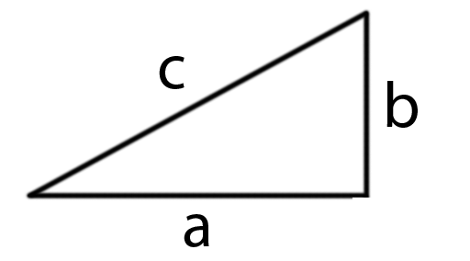


Pythagoras
To find the magnitude of a Vector we first need to look at Pythagoras’ Theorem
Pythagoras’ Theorem allows use to calculate the length of a right-angled triangle’s side if we know the lengths of the other two sides
$$a^{2}+b^{2}=c^{2}$$
$$\sqrt{a^{2}+b^{2}}=c$$

Slide 5





Pythagoras
Let’s try and solve for c, knowing that a is 6 and b is 4…
$$6^{2}+4^{2}=c^{2}$$
$$36+16=c^{2}$$
$$52=c^{2}$$
$$\sqrt{52}=c$$
$$c=7.211$$

Slide 6
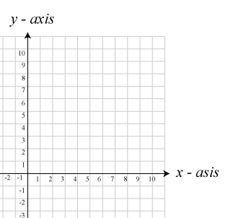






Pythagoras to find the Magnitude
We can use this method for finding the Magnitude of a Vector
A Vector’s X and Y represent offsets in each axis, much like the sides of a triangle
$$a^{2}+b^{2}=c^{2}$$
$$V=(8,4)$$
$$8^{2}+4^{2}=c^{2}$$
$$64+16=c^{2}$$
c
b
$$\sqrt{80}=c$$
a
$$magnitude=8.944$$

Slide 7


Magnitude
The mathematical representation of a Vector’s magnitude is $\left\|V\right\|$
$$\left\|V\right\|=\sqrt{{Vx}^{2}+{Vy}^{2}+…}$$

Slide 8
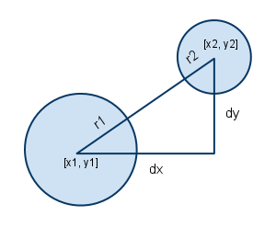
Magnitude Uses
Why would we want to know a Vector’s magnitude?
Track distance travelled
Track distance between two Points
Determine if a collision has occurred between shapes
Track speed
If an object has moved via a Vector with an (X,Y) of (3,4) then the speed of the movement is the magnitude of the Vector, which is 5
Magnitude can be used to track distance between two spheres, then subtract their radii to see if they overlap

Slide 9



Normalisation
In many cases we will need to modify a Vector so that its Magnitude is equal to 1
This process is called Normalisation
Normalising a Vector is a simple process once we can calculate its Magnitude
We simply scale the Vector by its Magnitude
This creates a Normalised Vector, called a Unit Vector
It has length of 1 unit
$$\left\|V\right\|=\sqrt{{Vx}^{2}+{Vy}^{2}+…}$$
$$\hat{V}=\frac{V}{\left\|V\right\|}$$
$$\hat{V}(x,y,…)=(\frac{Vx}{\left\|V\right\|},\frac{Vy}{\left\|V\right\|},…)$$

Slide 10
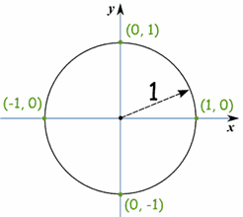
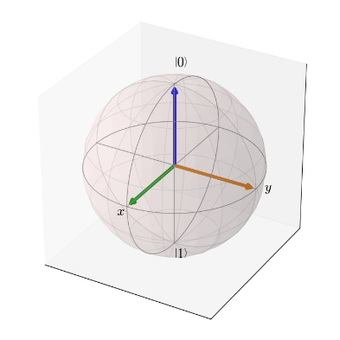
Unit Vectors and the Unit Sphere
Unit Vectors also are related to what is called a Unit Circle, or Unit Sphere
A 2-D circle with a radius of 1, or;
A 3-D sphere with a radius of 1
Any normalised Vector would plot a point on the surface of this circle or sphere

Slide 11
Normalisation Uses
Normalisation is used in many calculations
You will see more uses in a following lesson on Dot and Cross Products where Normalised Vectors can be used to track angles between directions
Normalisation is extremely useful in calculations based off of distances
For example, to travel in direction V at 5 units per second I would need to ensure V has a Magnitude of 1, then I can scale it by 5
If V wasn’t normalised, maybe its magnitude was 3, then scaling by 5 would result in a Vector with length 15 rather than 5!

Slide 12
Summary
Magnitude refers to the length of a Vector
Important for tracking distances between points, distance travelled, distances between collisions and many more
Uses Pythagoras’ Theorem
Normalisation is the process of ensuring a Vector is Unit Length
A Vector will then have a Magnitude of 1
Useful for many different calculations

Slide 13
Further Reading
Dunn, F, Parberry, I, 2011, 3D Math Primer For Graphics And Game Development, 2nd Edition, CRC Press
Lengyel, E, 2012, Mathematics for 3D Game Programming and Computer Graphics, 3rd Edition, CENGAGE Learning

